Slide 1
The Scottish Prevention Hub
Dr Diane Stockton, Public Health Scotland
Clair Thomson, Police Scotland
Dr Kristy Docherty, Edinburgh Futures Institute
Notes:
Brief Intro – order Kristy, Diane, Clair

Slide 2
Overview
Overview of current conditions
About the Prevention Hub
Exploring the challenge of collaboration
Collaborative Leadership – our underpinning methodology
Notes:
Clair

Slide 3
JOINT STRATEGY FOR POLICING 2023
Justice in Scotland 2022: Vision &
Priorities outcomes
Scottish Government – Public Health Related Strategies
The National Performance Framework
Notes:
Clair

Slide 4
Demand Analysis - 2022
OFFICIAL – POLICE ONLY
Vulnerability
Long term trends (5 year 2017/18 – 2021/22)
46% increase
Mental Health Markers
20%
increase
Drug Concern
Markers
97%
increase
Child Sexual Abuse & Exploitation
Referrals
36%
increase
Child Concern Markers
60%
increase
Adult Concern Markers
Females within iVPD
From analysis of female nominals recorded on iVPD we are seeing a substantial increase in vulnerability markers such as ‘Sexual Harm’ and ‘Mental Health’ over the last five financial years.
Victims of Sexual Crime
The data shows you are substantially more likely to be the victim of sexual crime if you are female, and males make up the majority of all offenders in this crime group.
Rising Cost of Living & Mental Health
Exploring persons within iVPD flagged as 'financially at risk' the data shows both genders have seen a rise over the last 5 years, with males seeing a faster rise of 63% compared to females at 23%.
Missing Persons
Missing Person rates appear to correlate with age, however you are substantially more likely to become a missing person under the age of 16 than in any other age group.
The continued rise of mental health and vulnerability markers appears set to continue due to societal impactors such as the rise in the cost of living and long lasting effects of the pandemic.
The data appears to flag clearly that young people and females are some of the most vulnerable in our society, being significantly more likely to become a missing person or the victim of a sexual crime.
4
Notes:
Clair

Slide 5
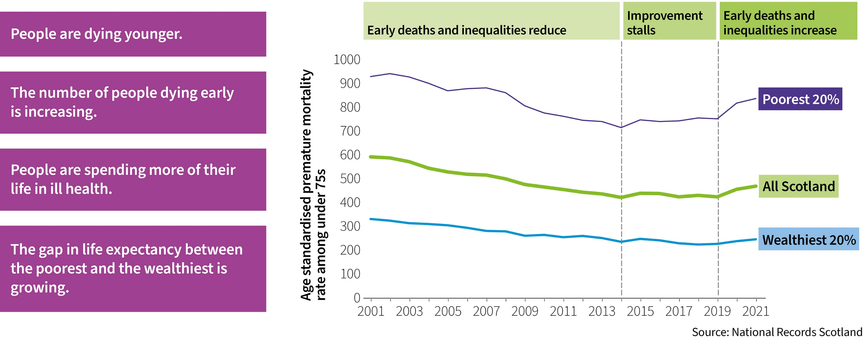
After decades of improvement, Scotland's health is worsening
Notes:
Diane

Slide 6
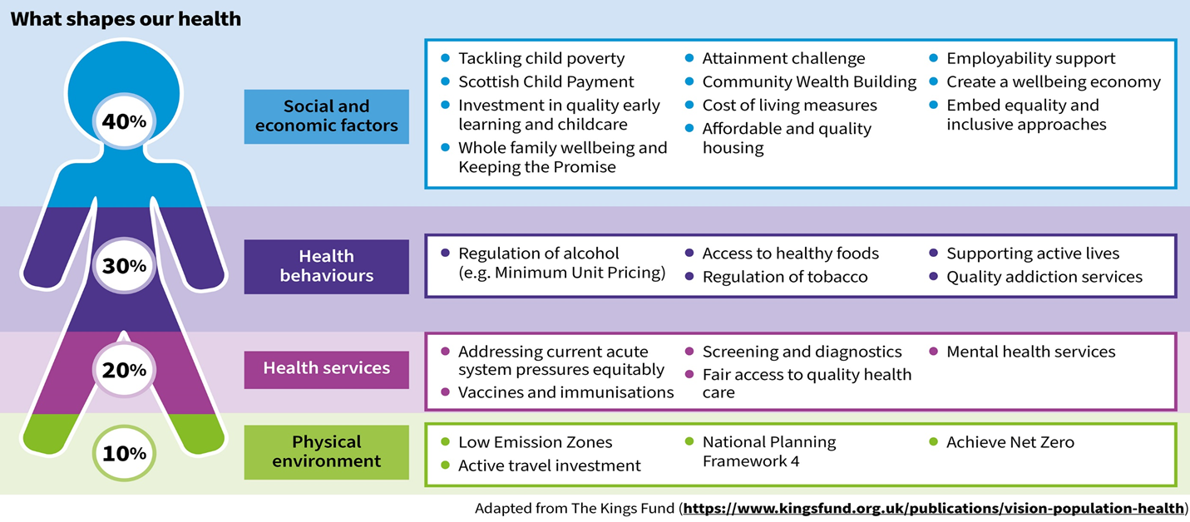
Determinants of Health
Notes:
Diane

Slide 7
Three Levels of Prevention
Primary Prevention
Representing the most challenging area to effect change
Resistant to change and entrenched challenges
Comparatively low in numbers but represent a large proportion of individual, family and community harms
Interventions are targeted, intensive and time-consuming
Medium level response, targeting those on the cusp or involved at low levels
Behaviour is not yet entrenched
Secondary prevention level responses are more targeted than primary population level Programmes and interventions are designed to either halt/slow and reverse behavioural trajectories
Population level responses designed to reduce the effect of negative drivers.
Can most easily be identified as policy e.g. pre birth and early years programmes, all levels of education, minimum unit pricing, weapons legislation
Intended to reduce the number of individuals, families or communities requiring support at secondary or tertiary levels
Notes:
Diane

Slide 8
Long-term investment in prevention: every sector has a role
Scottish Government
Local Government
Health and Social Care
Communities and Third Sector
Business
Wider Public Sector
Notes:
Diane

Slide 9
Background and context
Collaboration Agreement between Police Scotland and Public Health Scotland in (July 2021) – Public Health Approach to Policing
Memorandum of Understanding between EFI, Police Scotland and Public Health Scotland (June 2023) & launch (August 2023)-establish The Scottish Prevention Hub.
Learning from Collaboration Leadership Pilots, draw from what is happening, connect and join up.
Notes:
Clair

Slide 10
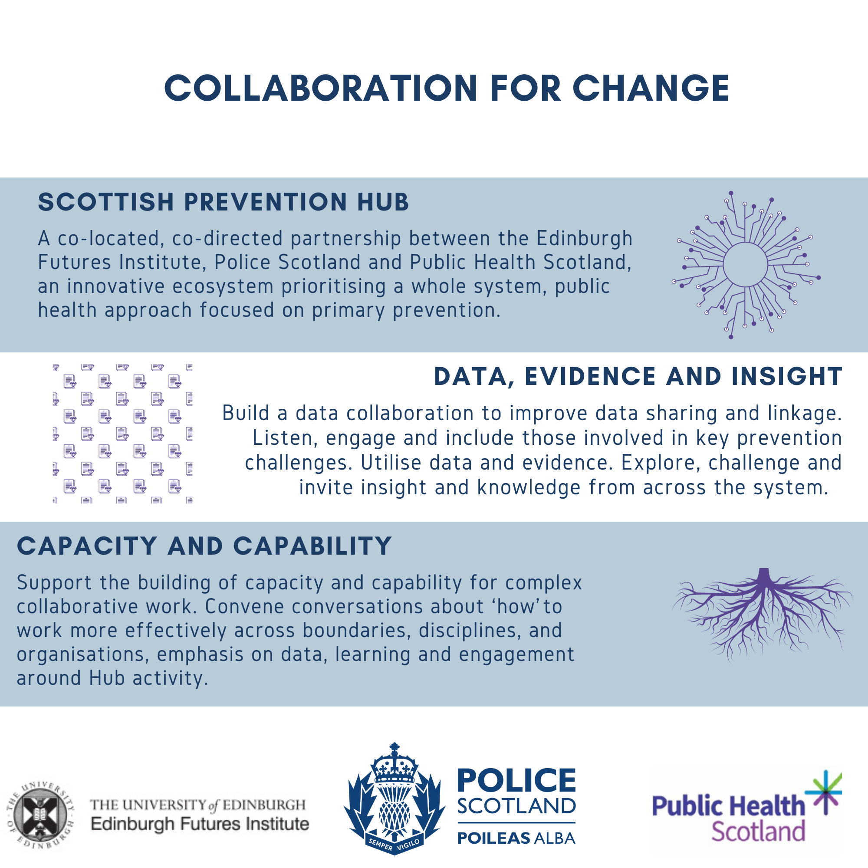
The Scottish Prevention Hub
Reduce health and wellbeing inequalities
with a focus on primary prevention
Notes:
Clair

Slide 11
The Scottish Prevention Hub - Why?
01
02
05
Christie Commission
Resource Spending Review
Fragmented System
Widening Inequalities
Public Service Sustainability
Empowerment, Integration, Prevention and Efficiency.
Continuing pressures facing the Scottish budget.
Need to collaborate, coordinate and connect local and national responses.
Scotland's health is worsening. Change is possible through investment in primary prevention.
Increasing demand, low morale, scrutiny, digital and tech advances and tightening public sector finances.
07
09
Health and Justice Links
Benefit of Public Health Approach
Complexity of Collaboration
Convene Wider Partner Involvement
Address Data Sharing Barriers
Factors leading to poor health such as ACEs, poverty, social exclusion, addiction increase the likelihood of crime.
Active commitment to prevention and the evidence, evaluation and assessment of its impact.
Pay attention to collaborative leadership and building the capability and capacity for the work.
Single organisations do not have all the answers, generational harm cannot be undone easily.
Difficulties around data-sharing present significant barriers to delivering more joined-up services to citizens.
Notes:
Clair

Slide 12
The Scottish Prevention Hub – Key Workstreams
Data Collaboration
Research & Evidence
Insights
Collaborative Leadership
Learning
Co-location
Build a common data platform - real-time linked data to inform - operations, policy and research
Enable Challenge led co-designed research + what works
Capture and catalyse to drive all workstream activity
Build capacity and capability for complex work
Transform learning experiences - share, inspire & empower
Re-design for collaborative working – practices, efficiencies, sustainability & impact
1
2
3
4
5
6
Notes:
Clair and Diane

Slide 13
Notes:
Kristy

Slide 14
The Scottish Prevention Hub – Underpinning Methodology
Notes:
Kristy

Slide 15
System-focused
Adopting a systems mind-set requires thinking about the contributions, processes and outputs from all relevant organisations across any given system, including citizens, all of which are considered to impact on an outcome.
The idea of ‘opening up’ issues, in order to make sense of them and any potential root causes, inspires and alters the conversations that people choose to have.
Docherty, K., 2021. Exploring collective leadership and co-production: an empirical study. In Processual Perspectives on the Co-Production Turn in Public Sector Organizations (pp. 130-155). IGI Global.
Notes:
Kristy

Slide 16
Emergence
Taking an emergent approach (as opposed to a planned style) consists of a continuous process of experimentation and adaptation, which may result in small to medium incremental adjustments, leading to ideas, innovation and change.
This style of working disrupts traditional patterns, with new ideas and opportunities thought to emerge out of the process. Collective thinking and sense making is encouraged as group members strive to maintain an openness to stay with whatever emerges.
Docherty, K., 2021. Exploring collective leadership and co-production: an empirical study. In Processual Perspectives on the Co-Production Turn in Public Sector Organizations (pp. 130-155). IGI Global.
Notes:
Kristy

Slide 17
Being Relational
Taking a conscious step towards getting to know other people and their work, beyond the polite salutations, and privileging relational matters above or equal to a task, can adjust typical communication and behavioural patterns.
Emphasis is given to the importance of bringing the whole person into the room, rather than representations of a role or an organisation. It is through these exchanges that diverse viewpoints are more comfortably shared, as members relate together, shaping a new course of action.
Docherty, K., 2021. Exploring collective leadership and co-production: an empirical study. In Processual Perspectives on the Co-Production Turn in Public Sector Organizations (pp. 130-155). IGI Global.
Notes:
Kristy

Slide 18
Inquiry led
Beginning an inquiry into the group process, the issue or problem, and any deeply held personal values, behaviours and beliefs, promotes a quest for fresh learning, the need to be open and curious, asking more questions and enabling different perspectives to be aired.
It seeks to merge the subjective (what do I think) with the intersubjective (what do we think) and the objective data (what has been done already and what was the result), in order to enrich self-awareness and shape a different way of working
Docherty, K., 2021. Exploring collective leadership and co-production: an empirical study. In Processual Perspectives on the Co-Production Turn in Public Sector Organizations (pp. 130-155). IGI Global.
Notes:
Kristy

Slide 19
What’s Next?
Move into our base at the Edinburgh Futures Institute.
Continue to develop and deliver on our key activities linked to Prevention and our 6 workstreams.
Communicate what we are doing as much as possible and involve wider partners.
Explore and share our experience of collaborative leadership in action, build momentum for further support/learning linked to growing capacity for complex collaborative work.
Notes:
Kristy

Slide 20
Thoughts, feedback, questions
Thanks for listening. Please contribute via the chat with any questions or thoughts.
Thinking about what you have heard today and drawing from your own experiences, what do you think enables and gets in the way of 1. effective collaboration and/or
2. primary prevention initiatives?
Notes:
Kristy

