Slide 1
Diversity Coffee Connect: Empowerment and my leadership journey 18th April 2023

Slide 2
Empowerment and my leadership journey
On 18th April 2023, we invited Leading to Change community members to come together to explore the theme of ‘Empowerment and my leadership journey’ in the context of equality, diversity and inclusion through informal conversation and reflect on what opportunities can emerge within our own teams and organisations.
Flow of the session:
Welcome
Overview of linked equalities blogs
Prepare and move into groups
Group conversations
Plenary/ Final reflections
Our conversation starters were:
What are the key lessons that I can take from this journey?
What can I do differently that will have an impact on myself as a leader?
Am I speaking to enough of the right people to help me?
How can I overcome barriers or help others to do so?

Slide 3
Who joined us?
Leading to Change exists to support leadership at all levels and at all stages, in all roles across health, social care, and social work in Scotland. The purpose of the Diversity Coffee Connect series is to provide a safe environment to explore the context of equality, diversity and inclusion together through informal conversation and so these events were open to all.
We were joined by 10 colleagues from across health, social care, and social work in Scotland.
Participants joined us from a range of organisations across Scotland, including: Scottish Ambulance Service; Blackwood Homes & Care; Robert Gordon University (Social Work); Abbotsford Care; NHS National Services Scotland; Territorial NHS Health Boards such as Grampian; and NHS Education for Scotland.

Slide 4
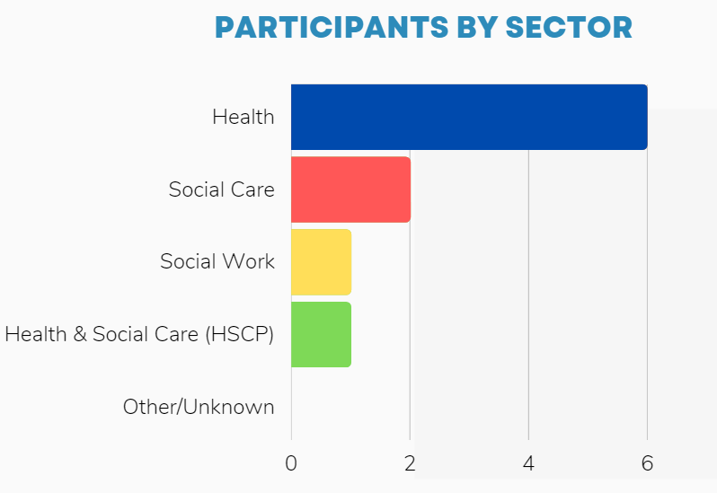
Who joined us?

Slide 5
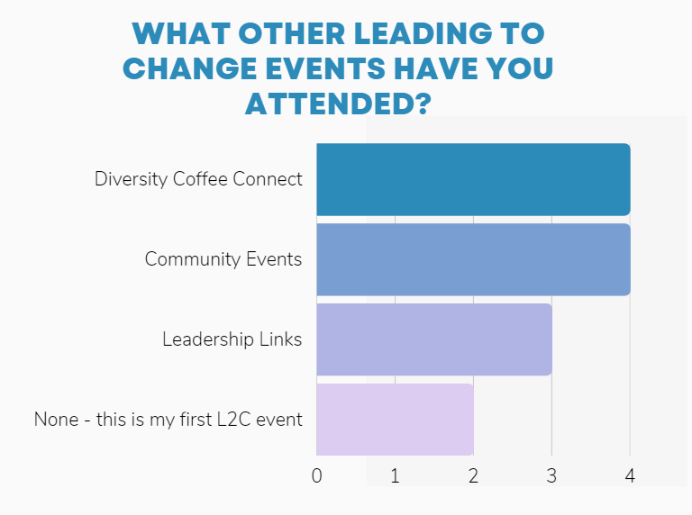
Was this your first Leading to Change event?

Slide 7
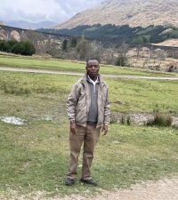
Empowerment and my leadership journey – Dr. Kennedy Muturi Nelson
There will have been many people involved in your leadership journey – family, friends, teachers, colleagues, managers.
It is important to have a solid foundation
Try and seek views, help and support from a wide variety of backgrounds
Huge value in being the mentor and mentee
There is a lot of power in being vulnerable and asking questions – this requires emotional intelligence
There is a need to help people feel fulfilled in their work – telling them what to do rarely works
You may have stories that are unhelpful – try and get rid of that baggage
Reflective challenge: How can you to seek mentors to support you, and also mentees who can learn from you? Who can you approach or what networks can you access?
Notes:
Dr Kennedy Muturi Nelson
Nelson is Associate Director for digital services with responsibility for several programmes including the replacement of the Nation Pharmacy payments system, Digitisation of Medical Records in Primary care and modernisation of data collection and reporting. He is also the Chair of the NSS ethnic, cultural diversity and friends’ network and co-convenor of the Global Citizenship Programme.

Slide 8
What was your response from the blog
Your comments included...
“Much of what Nelson said resonated with me, particularly the "fostering of negative thoughts" being baggage. This is something I could work better on.”
‘important to seek out networks and you can both feed in and gain something from them’
“'Don’t be afraid to ask or be asked questions because leadership is about both courage and vulnerability.'”
“The movement between asking and being asked questions is thought provoking’’
“I think there are some many struggles but also so much satisfaction from successful completion of the climb. ”
“I can relate to what Nelson has said and agree about vulnerability as a leader being a key tool”

Slide 9
Breakout rooms: facts and figures
2 breakout rooms
time in break out room: 30 minutes
EVENT Duration: 60 minutes

Slide 10
Key conversation themes
The themes from our conversations included...
“Diversity in leadership leads to a more thriving leadership and better solutions
“create a mission statement for yourself’’
“Mentorship”
‘Personal resilience’
“Belonging in leadership’’
“don’t be afraid to ask.”
“The importance of mentors”
“Allowing our young to grow up embracing diversity”
“Making connections’’
“Passing on knowledge you have gained”
‘connect connect, connect’
“Diversity”

Slide 11
Word Cloud: Enablers and opportunities
All responses in plain text: reconnecting, connection (3), being a mentor/mentee, acknowledging vulnerability, belonging (3), conversation, Arena, mission statement, clarity, value of diversity, Being kind, support

Slide 12
What action are you going to take away from the session today?
Responses included...
“create my own mission statement, identify a potential mentor and ask them to engage, use the question 'how was the journey for you'”
“To connect more with others to give wider perspective and understanding. ’’
“Reconnect with others including my mentor’’
“Take a step back to re-examine current networks and value them more’’’
“It's ok not to have all the information. Seeking help from others is powerful..”
“Allow myself to be vulnerable and criticise myself for exposing a vulnerability.

Slide 13
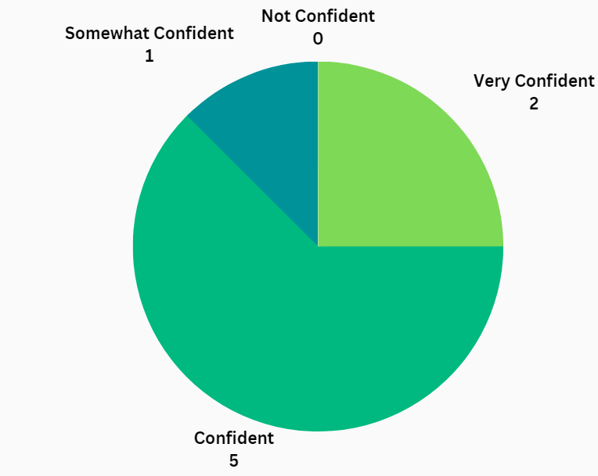
How confident are you now in seeking help and support from others in your own leadership journey?

Slide 14
Feedback
We asked participants for their reflections on the session. 4 participants (40%) responded to our feedback survey.
Their reflections included:
What participants said about this event
‘’Making connections system-wide is beneficial’’
‘’Safe Learning Space’’
“I enjoy the conversations and gaining further insight into the topic and challenges faced.”
“Both sessions I have attended have been really enjoyable, I have learnt and made excellent connections.’’
‘’ Sessions are insightful..’’
4
out of 4 respondents said that DCC event felt like a psychologically safe space
4
out of 4 feel very confident, confident or somewhat confident to start an equality, diversity and inclusion conversation with their colleague, manager and team
4
out of 4 would attend a Diversity Coffee Connect session in the future

Slide 15
Feedback
Gender Equality
Neurodiversity
Inclusion
Challenging conversations
Anything around leadership and EDI
Hidden Diversity
Addictions, Alcohol and drug issues
Health inequalities
Resilience within teams
Intentional Inclusions and microaggressions-different levels of acceptance
Reducing barriers such as language
Mental Health Stigma
Disability in the workplace,
LGBT+
Sharing stories of hope and inspiration-positive changes academic expectations of employees
Your suggestions for future themes and conversations
Decolonising structural inequalities in social work / social care settings and decolonising professional learning / teaching.
To have an open discussion about the structural barriers for the engagement of ethical marginalised communities.
Positive Action Strategies for HR Teams to address areas of under representation
Acceptance of differences
Mental health & neurodiversity co-morbidity
Emotional intelligence in diversity setting
Social mobility
Inequity
How to attract a diverse candidate pool
Notes:
From registration data

Slide 16
Next events in the series
Diversity Blog Series
The next series and of DCC events will be announced in May 2023

Slide 17
Resources available
Resources available
Recognise that this may have raised some issues that you recognise in yourself or others.
National Wellbeing Hub: https://wellbeinghub.scot/
Coaching for Wellbeing: https://wellbeinghub.scot/resource/coaching-for-wellbeing-a-digital-coaching-service-for-all-health-and-social-care-staff/
Other national services: https://wellbeinghub.scot/national-services/

Slide 18
How to Find Out More
Website: https://leadingtochange.scot/
Follow us: https://twitter.com/L2CScot
Like us: https://www.facebook.com/L2CScot/
Email the team: hello@leadingtochange.scot
Keep in touch: Leading to Change weekly email
Notes:
11:25-11:30
JENNY– 5 mins (slides 8 & 9)
Sign up to weekly email via website
Join us at an in person Taster session next year
Follow us on twitter
Ideas for future development offers? Email us

Slide 19
Thank You!
If you have any questions about anything in this pack or any of the events in the series, feel free to contact us at: hello@leadingtochange.scot

